Slide 1
CMPE 272 Project Summary
Group 5

Slide 2
Agenda
Problem statement/Revenue impact
Solution overview
Demo

Slide 3
Problem Statement
Product/industry complexity is increasing faster than a technical sales force can learn
These are among the most complexes and diverse products on earth
Massive configurability – the more functions we can absorb the more values our devices generate
Product features that go unused or Industry feature demand that will be addressed by competitors products

Slide 4
Solution Overview
Give executive management crystal clarity on what we, as a corporation, are doing to shape the talent of our Technical Sales Force
Optimize response to changes in the competitive landscape
Enable an informed debate on the balance of training investment in all technical areas
Drive high quality execution of training development plans
Offer the training content developer a simple method of managing and tracking progress against goals

Slide 5





The Training Management System
Web based application written in Python on Django hosted on Pythonanywhere
Product features
Sales Training Deliverable tracking from Idea to globally available training
Workflow that includes a queue for each team involved in training production
Real-time email notifications
Graphical real-time reports
Media
Services
Post
Processing
Training
Content Developers
Deployment

Slide 6
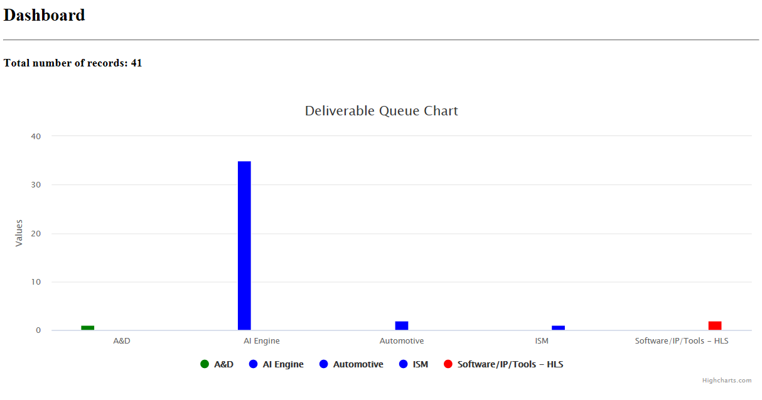
Sales Training Development Dashboard
Real-time graphical dashboard showing relative investment by topic area
Insight into process performance, real-time status, and problem areas could be derived from the same basic framework

Slide 7
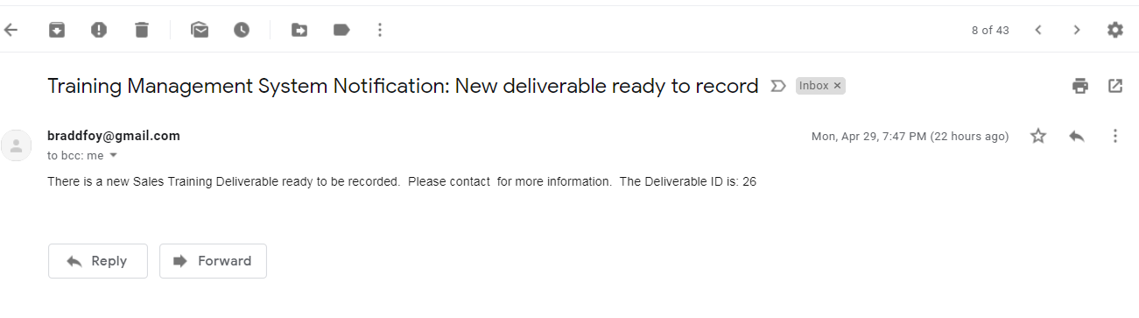
Real-time Email Notifications
Improved cycle time and team communication
Emails sent to warn the media services that a new training is ready to record

Slide 8
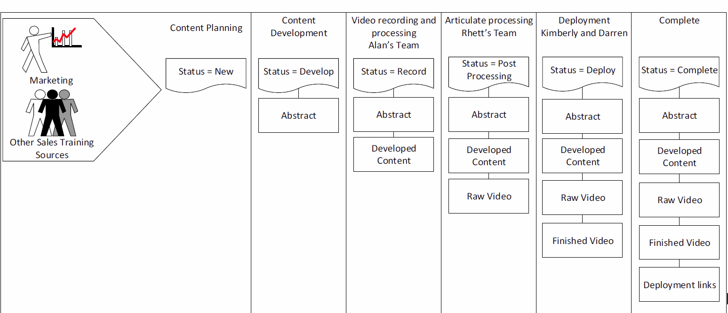
High Level Process Flow
Deliverables pass through a 6 step process to move from idea to a completed and globally available Sales Training course
New – Idea that may or may not be approved
Approved idea that is in development
Content complete – prepare for recording
Content recorded and in post production
Final training is ready for publication
Training is deployed and in production

